Slide 1
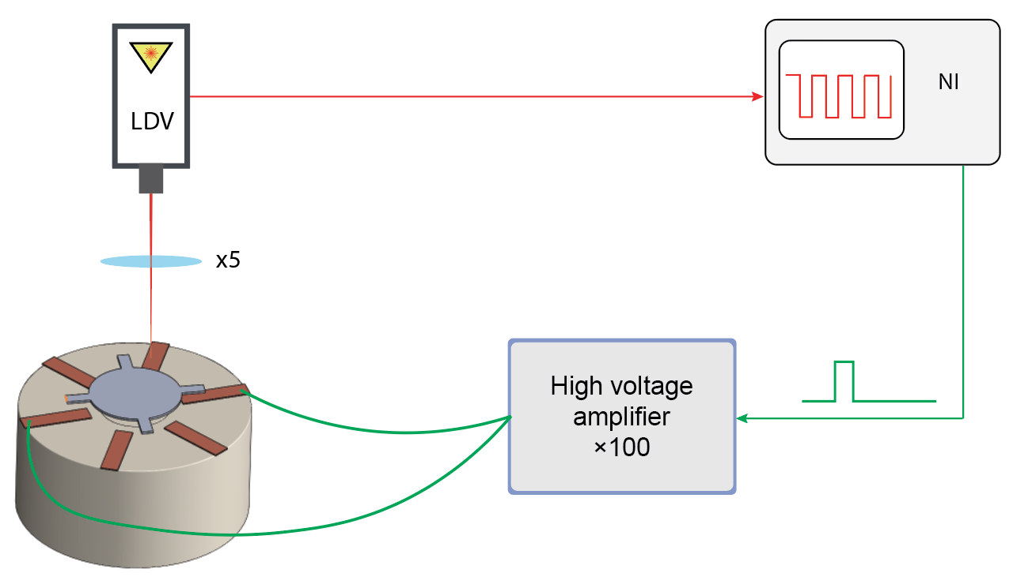
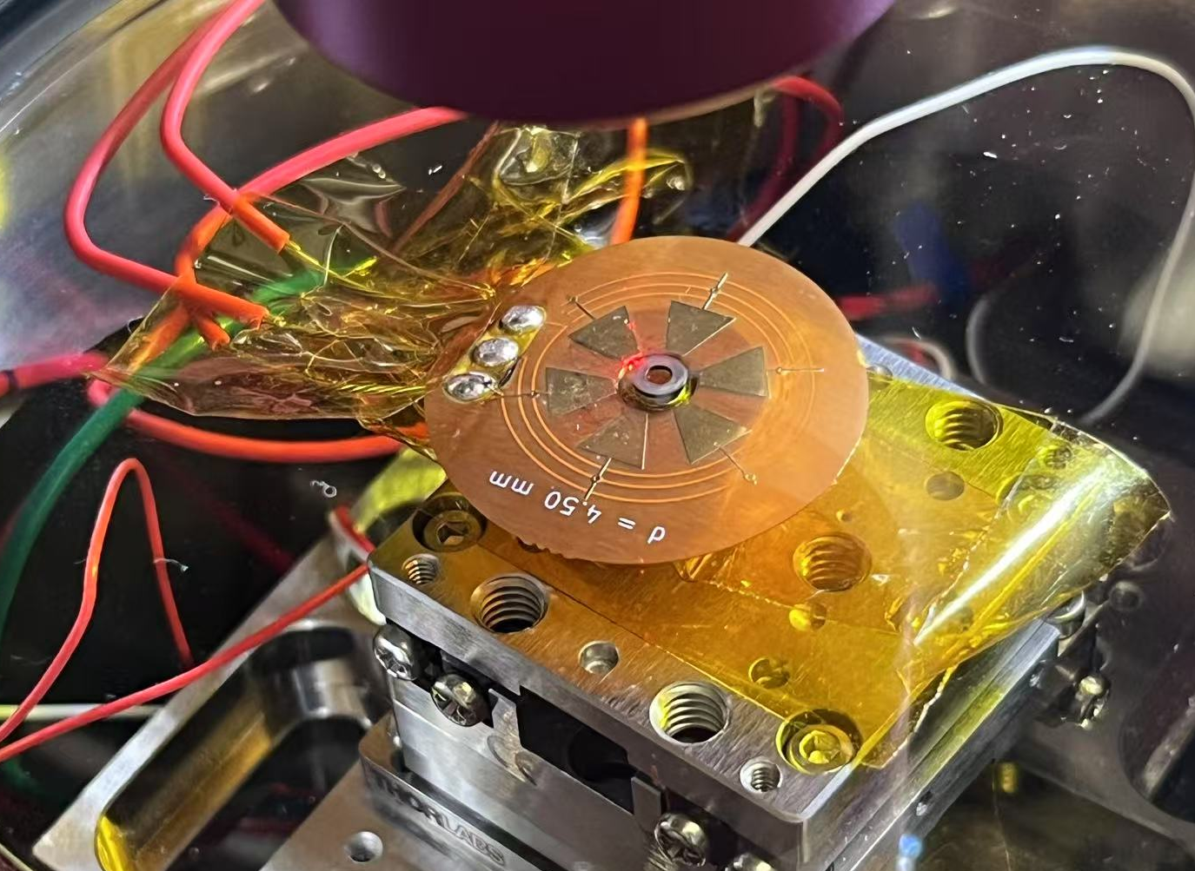
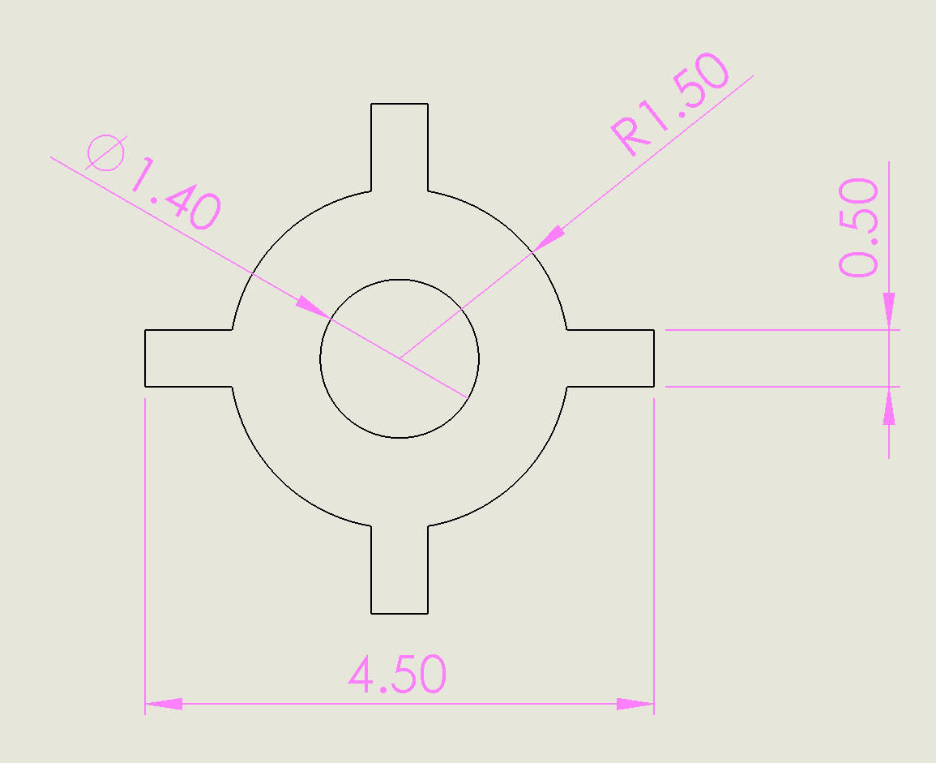
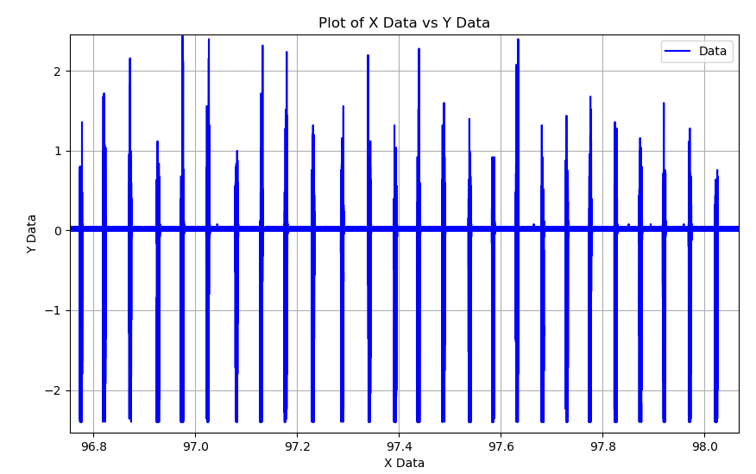
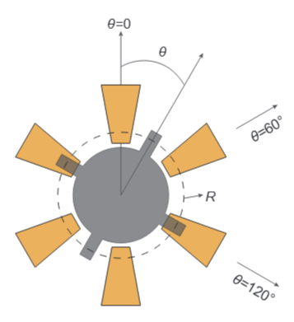
Measurement setup and strategy
Real shape of rotor, thickness=0.32mm
1
3
Trigger mode control strategy: When the LDV signal is higher than 0.2,
Electrode 3 are on.
3
1
LDV signal delay: 400us
LDV signal, raw data

Slide 2
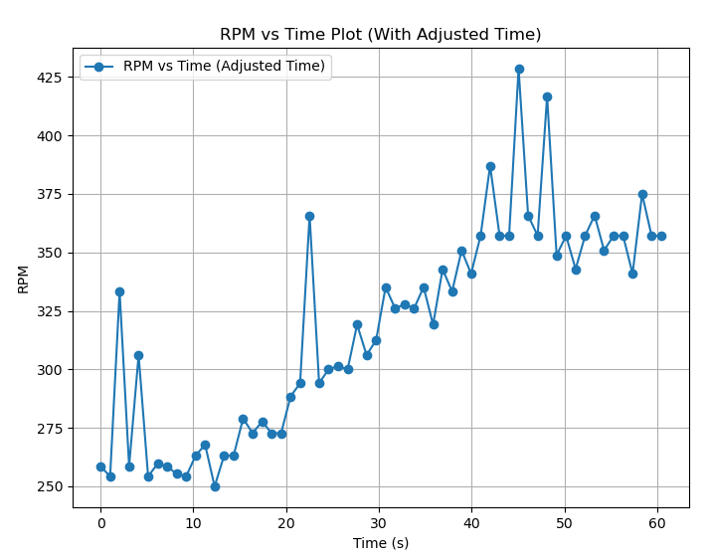
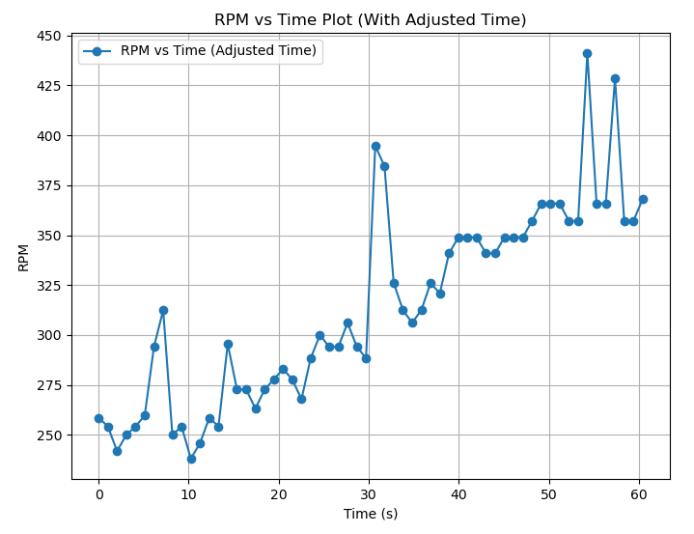
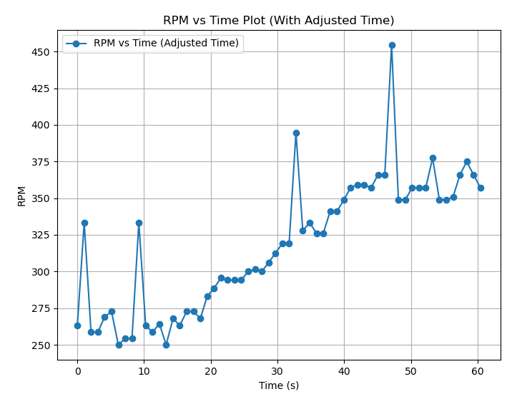
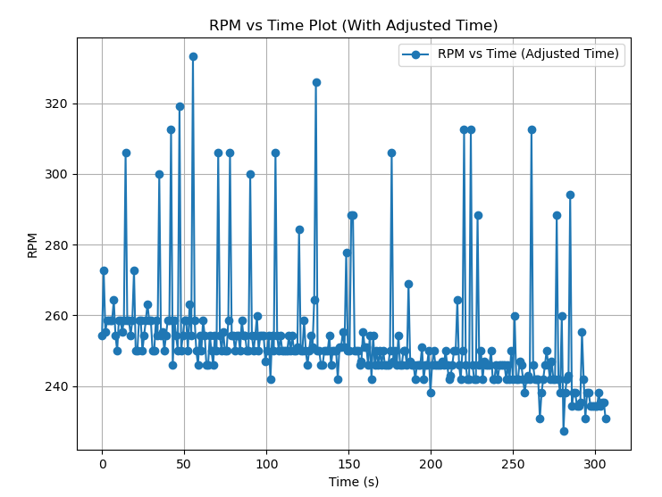
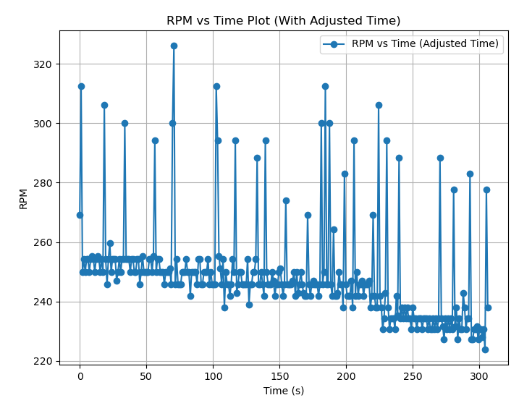
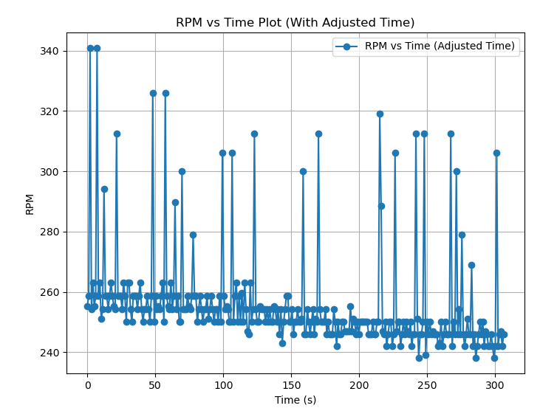
We drive the rotor into spinning at around 250rpm for 10s, then start the trigger mode control strategy (as descripted in the previous slide) for 50s
3 data set of ringdown measurement
The spikes are due to signal processing of the raw data

Slide 3
Known physical parameters
Thickness t(mm) | Density rho(kg/m³) | Effective arm R(mm) | Moment of inertia I(kg m²) | Levitation gap d0(mm) | Effective overlapping area A(m²) | Amplitude of voltage V0 (V) | Calculated Damping coefficient c (Kg m²/s) | Mass (mg) | Measured gamma c/I
0.35 | 2200 | 2 | 9.996e-12 | 0.3 | 1e-6 | 100 |  | 5.423
Magnets: For ring: D_out=12mm, D_in=3mm, H=6mm
For cylinder: D=3mm, H=6mm

